Slide 1



OPC UA Security
From Encryption Basics to Secure EPICS Integration
Ralph Lange

Slide 2
Background: Cryptography Encryption 101
Simplest traditional form: Symmetric (shared key) encryption
Both peers use the same key
Key needs to be shared using a secure path
Base of modern security: Asymmetric (key pairs) encryption
Uses complex mathematical one-way calculations/algorithms
What key A encrypts, only key B can decrypt What key B encrypts, only key A can decrypt

Slide 3
Foundation: Asymmetric Key Pairs Used for modern security protocols
Public key
Shared with everyone
Used to Encrypt data or Verify a signature
Private key
Kept secret on the device
Used to Decrypt data or Create a signature.
Key length and algorithm determine the safety level
Be aware of upcoming quantum computing

Slide 4
Workflow: Encryption vs. Signing Making key pairs useful
Encryption (Confidentiality)
Signing (Integrity and Authenticity)
Sender uses Receiver’s Public Key to lock the message.
Only the Receiver’s Private Key can open it.
Sender hashes the message
Sender encrypts it with their own Private Key.
Receiver uses Sender’s Public Key to decrypt the hash.
If it matches, the identity of the sender and the integrity of the message is proven.

Slide 5

X.509 Certificates Binding a Public Key to an Identity
How do I know the Public Key I just received actually belongs to the server I think it does?
The Certificate – a "Digital Passport" for your OPC UA Application A certificate is a digital document that binds a Public Key to an identity (Application Name, URI, Hostname).

Slide 6
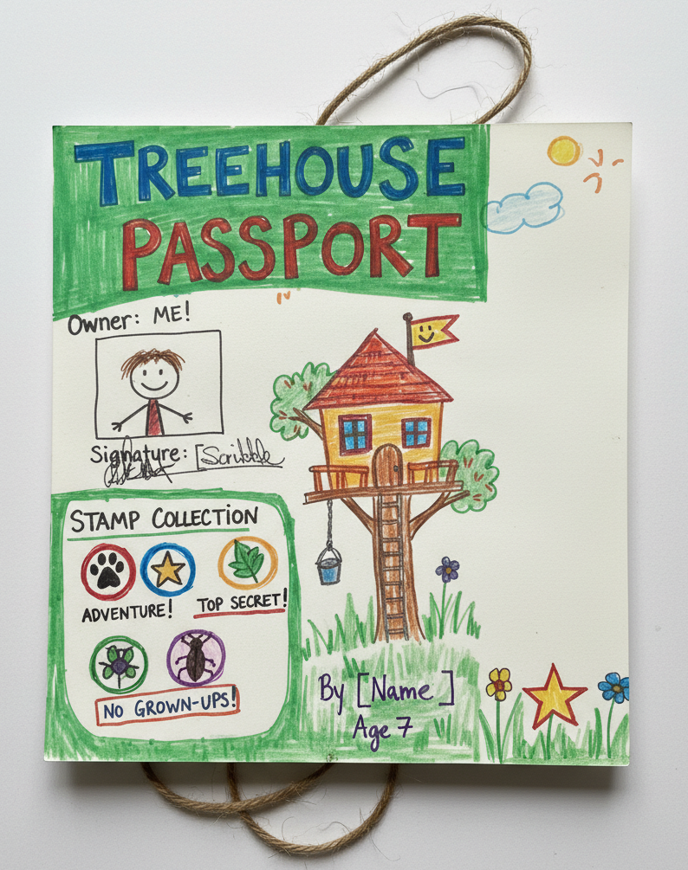
Trust Models: Self-Signed Certificate Kids’Play
I claim I am who I am I signed the document myself
Use Case: Small labs, internal testing, "Trust on First Use"
Does not scale well: peers need to individually trust every certificate
Easy to get working; great for development

Slide 7
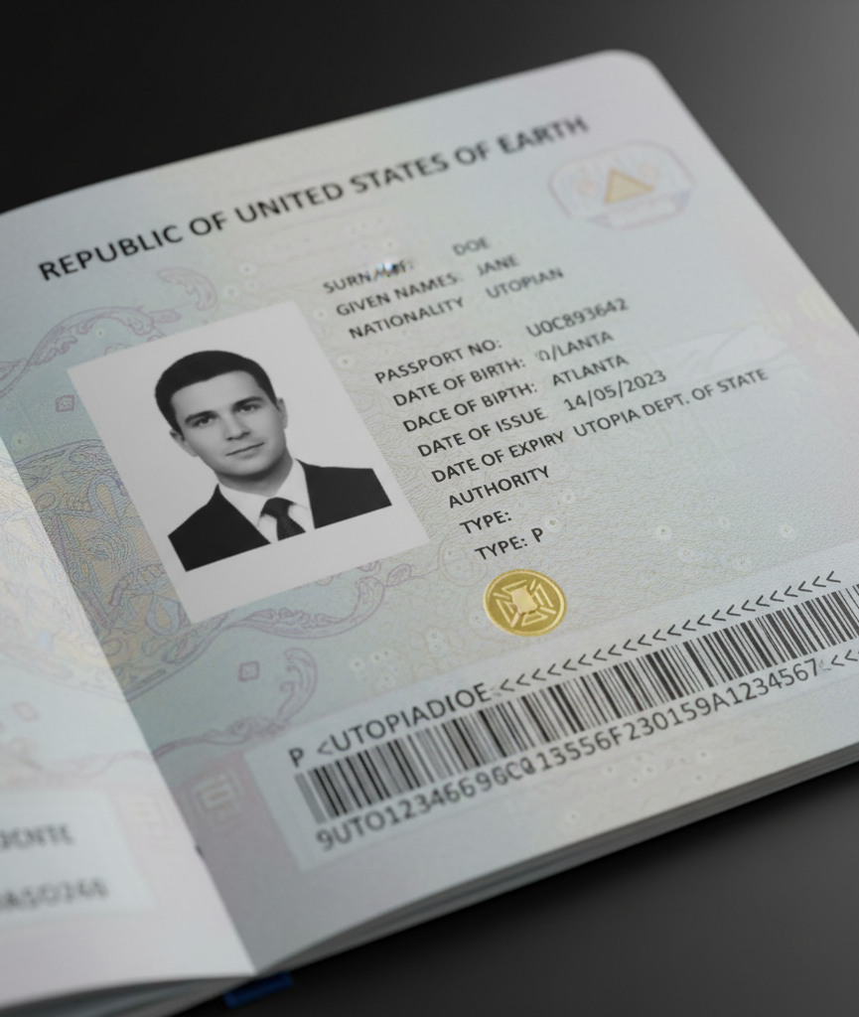
Trust Models: CA-Signed Certificate The Authority
A trusted third party (Certificate Authority) verified my ID and signed the document for me
Use Case: Production plants, enterprise-wide security
Peers only need the CA certificate
Adds considerable complexity and maintenance effort

Slide 8
Fact Mapping: Identification
X.509 Cert Certificate Fields: Subject Name, Application URI, Hostname
Passport Full Name, Date of Birth, Place of Residence
Both prove who the holder is supposed to be. If the Hostname on the cert doesn't match the IP the client connects from, the "Passport" is invalid for that person.

Slide 9
Fact Mapping: The Public Key
X.509 Cert Certificate Field: "Public Key Info“ (RSA/ECC)
Passport ID Photo, fingerprint
Photo and fingerprint allow you to recognize/verify the person in front of you. The Public Key allows the OPC UA Server to verify signatures and recognize encrypted traffic from the Client.

Slide 10
Fact Mapping: Validation & Trust
X.509 Cert Issuer Name and Digital Signature
Passport Government Seal and Issuing Authority (e.g., Dept. of State)
You trust the Passport because you trust the Government that signed it. In OPC UA, you trust the Certificate because you have the CA’s Certificate in your Trusted folder.

Slide 11


Secure OPC UA: The Handshake
Get Endpoints Client asks Server for security options
Open Secure Channel Client and Server exchange certificates
Check Trust Both sides check if the received cert is in their "Trusted" list (or signed by a trusted CA)
Create Session Identity is verified Encrypted communication begins

Slide 12
Security Policies in OPC UA
None No security – data in cleartext
Sign Ensures data isn't tampered with, but still cleartext on the network
SignAndEncrypt The gold standard – data is private; source and integrity are verified
Algorithms Extensible list (to keep up with crypto developments), e.g. Basic256Sha256 (common) Aes128Sha256Rsa15 (older) …

Slide 13
CA Chains of Trust
For easier certificate management, CA signatures can be chained:
RootCA self-signed root CA certificate – kept in the safe signs CA1 CA2 CA3 e.g. different locations signs signs signs CA11 CA12 CA21 CA22 CA31 sign 100s of client and server certificates
For verification, peers need the complete chain of CA certificates from the presented server or client certificate to the root CA
Certificate Revocation Lists (CRLs) are signed by a CA and distributed to invalidate specific signatures

Slide 14
The PKI File Store
PKI = Public Key Infrastructure tools and procedures to manage public keys for encryption
PKI File Store for OPC UA Standard directory structure for keeping public keys trusted/certs trusted peer and CA certificates of the other side trusted/crl revocation lists for the CAs in trusted/certs issuers/certs intermediate CA certificates for the own certificate issuers/crl revocation lists for the intermediate CAs
Certificates and CRLs must be in DER format Keys must be in PEM format

Slide 15
Top Reasons Why Connections Fail Be prepared for a *lot* of frustration
Untrusted Certificate: The Server's cert is not in the Client’s trusted/certs folder (or vice versa)
Hostname Mismatch: Connecting via IP, but the certificate only lists the DNS hostname
URN Mismatch: The URN that the IOC uses does not exactly match the one in the certificate
Clock Desync (NTP): If the Linux system time is 2010, but the cert was created in 2024, the cert is "not yet valid"
Expired Certificate: The "Valid Until" date has passed
CRL (Revocation List): The system is trying to check if the cert was revoked but doesn’t have a valid Revocation List

Slide 16
Fasten Your Seat Belts
We will now extend the OPC UA connection from the basic training to use Secure OPC UA between the IOC and the UA Demo server
You can follow along in the Training VM or watch and do it yourself later
But first: Any questions up to this point ??

